Slide 1
ANLY 5332
Department of Information Systems and Analytics
McCoy College of Business Administration
Texas State University
Formulations and more

Slide 2
Outline
Compact Formulation (not in the textbook)
Matrix Notation (not in the textbook)
Matrix Notation for Network Optimization (not in the textbook)
Examples (not in the textbook)
Phyton Introduction

Slide 3
Outline
Compact Formulation (not in the textbook)
Matrix Notation (not in the textbook)
Matrix Notation for Network Optimization (not in the textbook)
Examples (not in the textbook)
Phyton Introduction

Slide 4
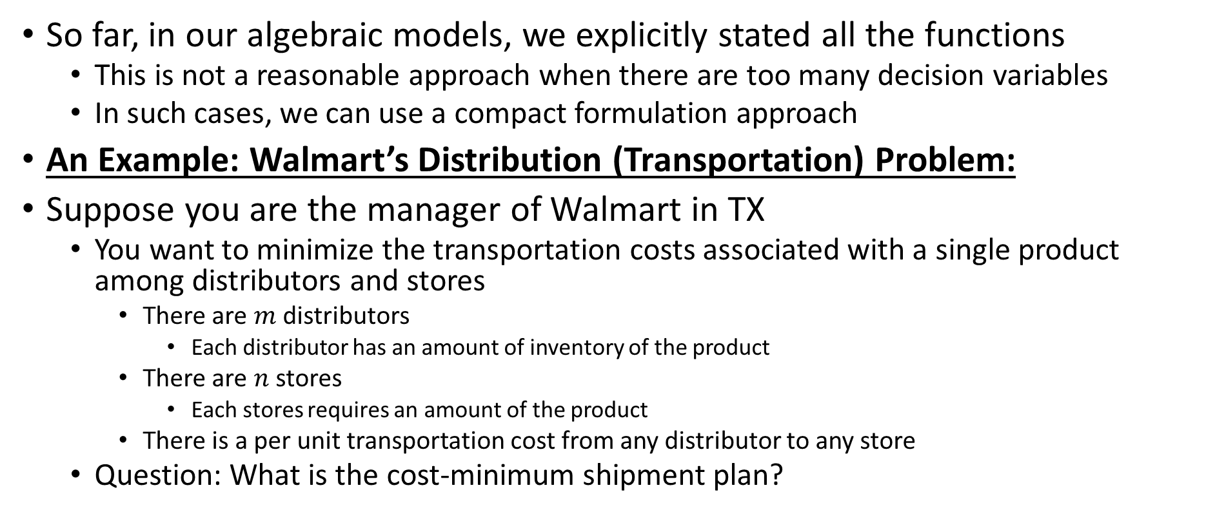
Compact Algebraic Modeling
So far, in our algebraic models, we explicitly stated all the functions
  This is not a reasonable approach when there are too many decision variables
  In such cases, we can use a compact formulation approach
An Example: Walmart’s Distribution (Transportation) Problem:
Suppose you are the manager of Walmart in TX
  You want to minimize the transportation costs associated with a single product among distributors and stores
    There are $m$ distributors
      Each distributor has an amount of inventory of the product
    There are $n$ stores
      Each stores requires an amount of the product
    There is a per unit transportation cost from any distributor to any store
  Question: What is the cost-minimum shipment plan?

Slide 5
Compact Algebraic Modeling
An Example: Walmart’s Distribution (Transportation) Problem:
STEP 0: Know the problem and gather your data
Let the distributors be indexed by i, i=1,2,…,m
→Supply limit of distributor i is Si
Let the stores be indexed by j, j=1,2,…,n
→Demand at store j is Dj
C_{ij}: unit transportation cost from distributor i to retailer j

Slide 6
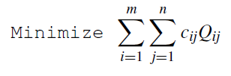
Compact Algebraic Modeling
An Example: Walmart’s Distribution (Transportation) Problem:
STEP 1: Decision variables
  We want to determine the shipment plan, i.e., how much to ship from each distributor to each retail store
    We have $m$ distributors and $n$ stores, thus, we will have $m×n$ decision variables
STEP 2: Objective and objective function
  We want to minimize the total shipment cost
Q_{ij}: amount shipped from distributor i to retailer j

Slide 7


Compact Algebraic Modeling
An Example: Walmart’s Distribution (Transportation) Problem:
STEP 3: Constraints
  We need to ship the demand to the retailer stores
  We cannot exceed the supply limit at the distributors

Slide 8
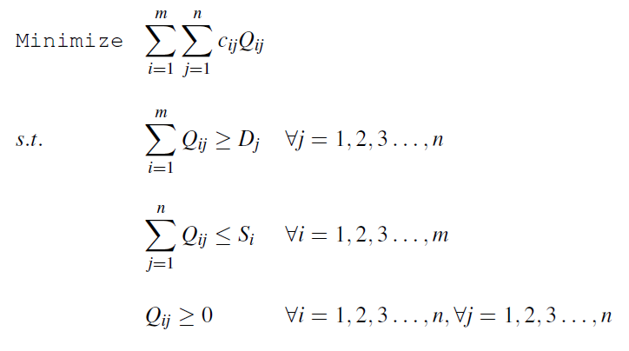
Compact Algebraic Modeling
An Example: Walmart’s Distribution (Transportation) Problem:
Combining everything, we have the compact formulation as follows:

Slide 9
Outline
Compact Formulation (not in the textbook)
Matrix Notation (not in the textbook)
Matrix Notation for Network Optimization (not in the textbook)
Examples (not in the textbook)
Phyton Introduction

Slide 10
Matrix Notation
So far, we discussed two approaches for algebraic modeling
  Explicit formulation → which has all the functions explicitly written
  Compact formulation → which uses notation and summation-notation to express the functions in a compact form
Different software asks for different forms of input
  GAMS, LINGO work with compact formulation
  Excel solver can be considered as explicit formulation
Another approach is the Matrix notation
  Even more compact than ‘compact formulation’ approach

Slide 11
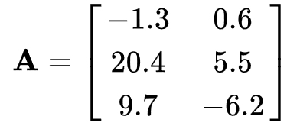
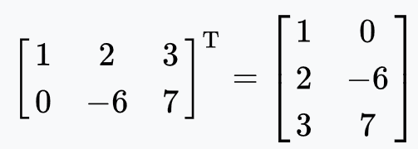
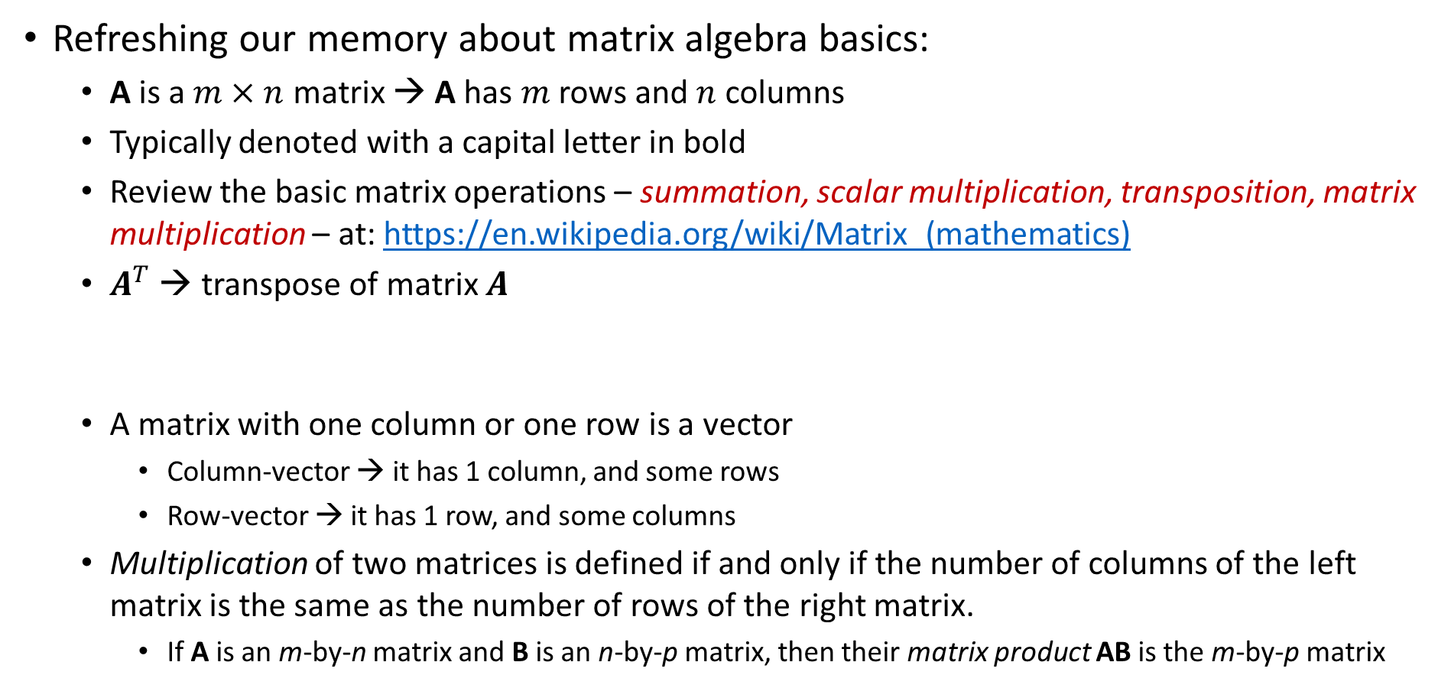
Matrix Notation
Refreshing our memory about matrix algebra basics:
  A is a $m×n$ matrix → A has $m$ rows and $n$ columns
  Typically denoted with a capital letter in bold
  Review the basic matrix operations – summation, scalar multiplication, transposition, matrix multiplication – at: https://en.wikipedia.org/wiki/Matrix_(mathematics)
  $A^{T}$ → transpose of matrix $A$
  A matrix with one column or one row is a vector
    Column-vector → it has 1 column, and some rows
    Row-vector → it has 1 row, and some columns
  Multiplication of two matrices is defined if and only if the number of columns of the left matrix is the same as the number of rows of the right matrix.
    If A is an m-by-n matrix and B is an n-by-p matrix, then their matrix product AB is the m-by-p matrix
    3-by-2 matrix:

Slide 12
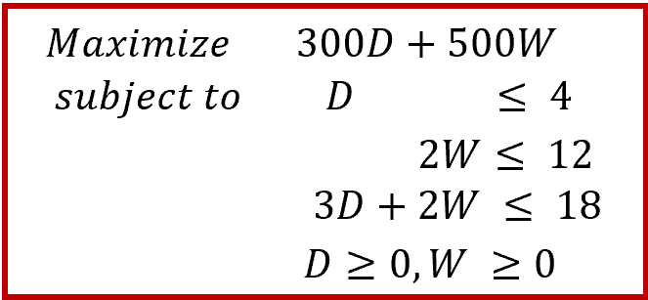
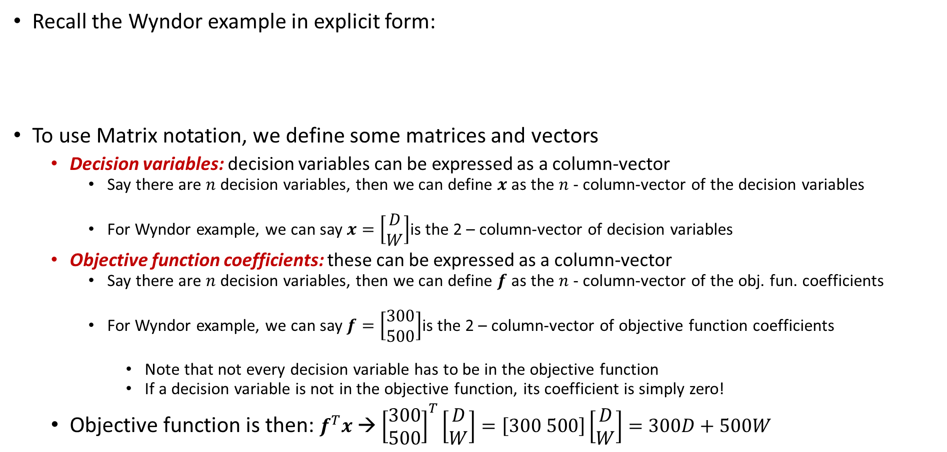
Matrix Notation
Recall the Wyndor example in explicit form:
To use Matrix notation, we define some matrices and vectors
  Decision variables: decision variables can be expressed as a column-vector
    Say there are $n$ decision variables, then we can define $x$ as the $n$ - column-vector of the decision variables
    For Wyndor example, we can say $x=\left[\begin{aligned}D \\ W\end{aligned}\right]$is the 2 – column-vector of decision variables
  Objective function coefficients: these can be expressed as a column-vector
    Say there are $n$ decision variables, then we can define $f$ as the $n$ - column-vector of the obj. fun. coefficients
    For Wyndor example, we can say $f=\left[\begin{aligned}300 \\ 500\end{aligned}\right]$is the 2 – column-vector of objective function coefficients
      Note that not every decision variable has to be in the objective function
      If a decision variable is not in the objective function, its coefficient is simply zero!
  Objective function is then: $f^{T}x$ → ${\left[\begin{aligned}300 \\ 500\end{aligned}\right]}^{T}\left[\begin{aligned}D \\ W\end{aligned}\right]=\left[300 500\right]\left[\begin{aligned}D \\ W\end{aligned}\right]=300D+500W$

Slide 13
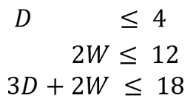
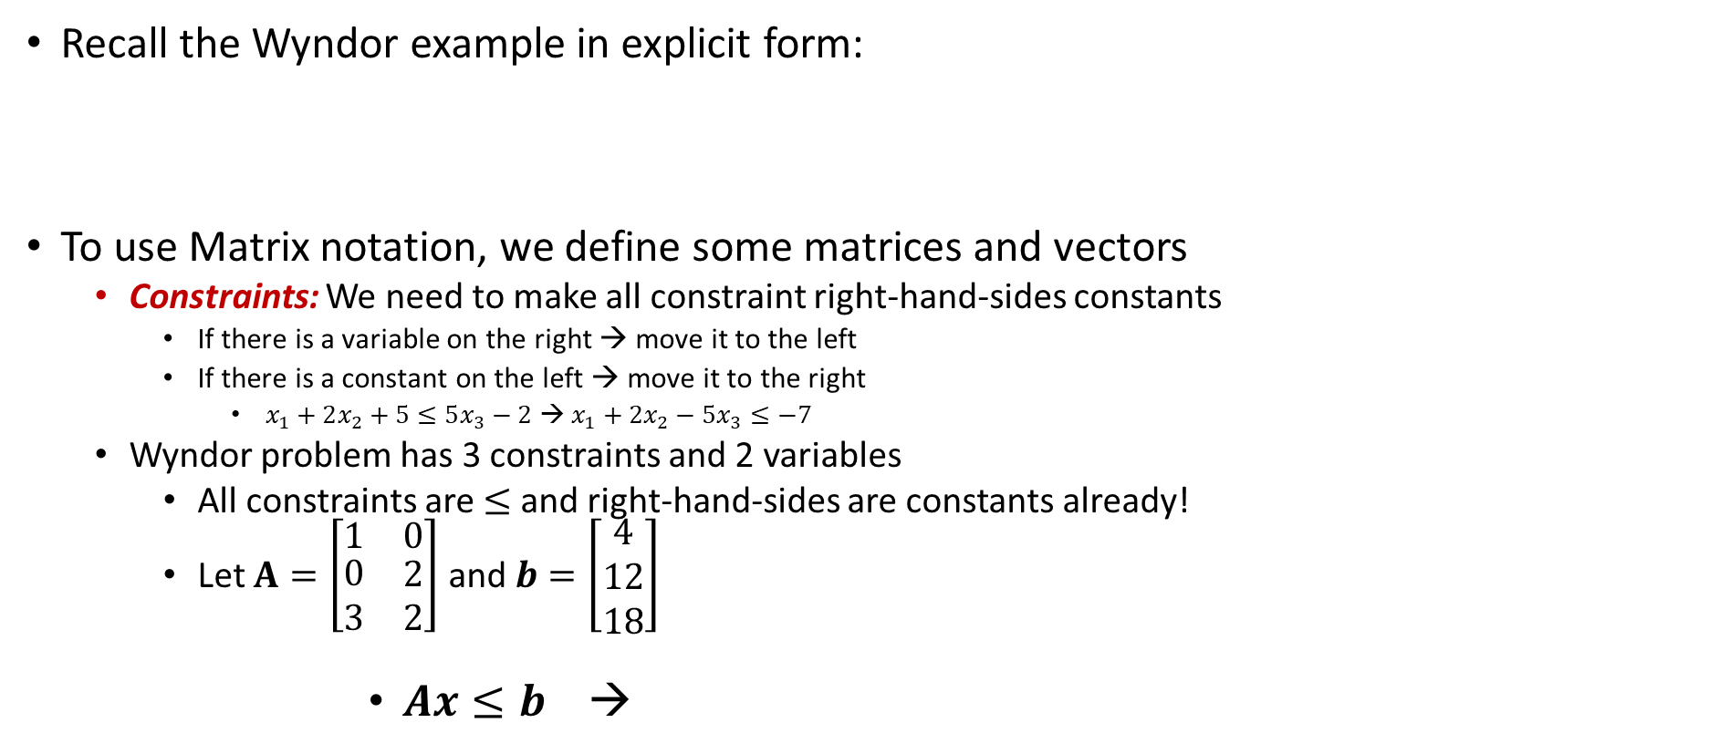
Matrix Notation
Recall the Wyndor example in explicit form:
To use Matrix notation, we define some matrices and vectors
  Constraints: We need to make all constraint right-hand-sides constants
    If there is a variable on the right → move it to the left
    If there is a constant on the left → move it to the right
      $x_{1}+2x_{2}+5≤5x_{3}−2$ → $x_{1}+2x_{2}−5x_{3}≤−7$
  Wyndor problem has 3 constraints and 2 variables
    All constraints are $≤$ and right-hand-sides are constants already!
    Let $A=\left[\begin{matrix}1 & 0 \\ \begin{aligned}0 \\ 3\end{aligned} & \begin{aligned}2 \\ 2\end{aligned}\end{matrix}\right]$ and $b=\left[\begin{aligned}4 \\ 12 \\ 18\end{aligned}\right]$
          $Ax≤b$ →

Slide 14






Matrix Notation
Recall the Wyndor example in explicit form:
The matrix notation of Wyndor problem:
    Where $x=\left[\begin{aligned}D \\ W\end{aligned}\right]$, $f=\left[\begin{aligned}300 \\ 500\end{aligned}\right]$, $A=\left[\begin{matrix}1 & 0 \\ \begin{aligned}0 \\ 3\end{aligned} & \begin{aligned}2 \\ 2\end{aligned}\end{matrix}\right]$ and $b=\left[\begin{aligned}4 \\ 12 \\ 18\end{aligned}\right]$, and $0=\left[\begin{aligned}0 \\ 0\end{aligned}\right]$
$$Minimize$$
$$f^{T}x$$
$$subject to$$
$$Ax≤b$$
$$x≥0$$

Slide 15
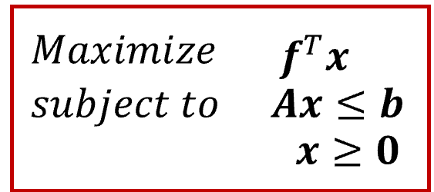
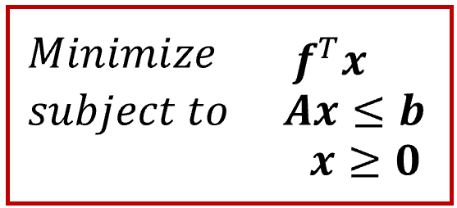
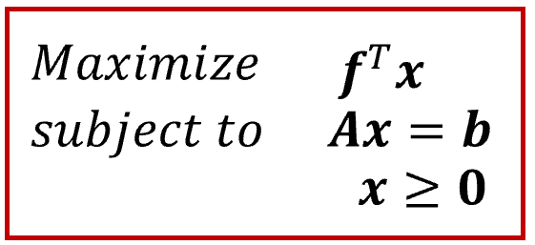
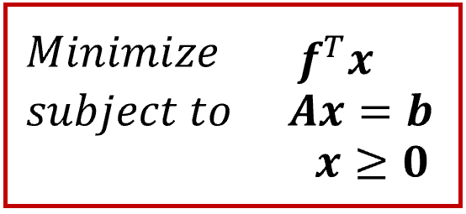
Matrix Notation
Any model can be converted into:
OR
Any model can be converted into:
OR
We can modify the constraints and decision variables as needed

Slide 16
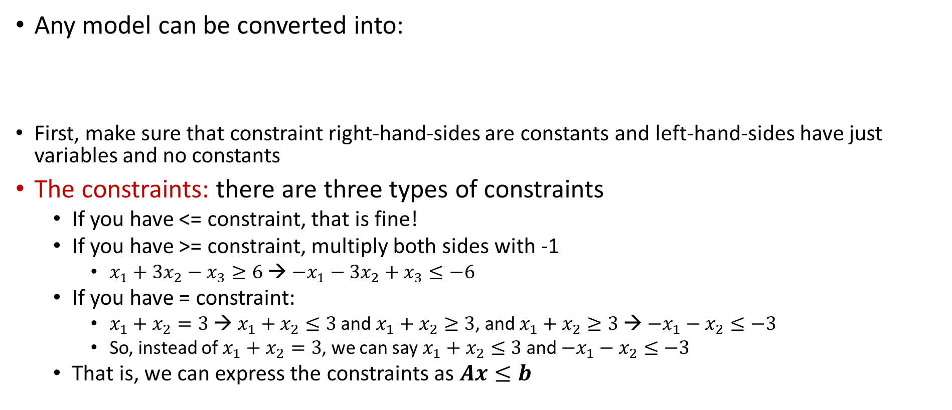
Matrix Notation
Any model can be converted into:
First, make sure that constraint right-hand-sides are constants and left-hand-sides have just variables and no constants
The constraints: there are three types of constraints
  If you have <= constraint, that is fine!
  If you have >= constraint, multiply both sides with -1
    $x_{1}+3x_{2}−x_{3}≥6$ → ${−x}_{1}−3x_{2}+x_{3}≤−6$
  If you have = constraint:
    $x_{1}+x_{2}=3$ → $x_{1}+x_{2}≤3$ and $x_{1}+x_{2}≥3$, and $x_{1}+x_{2}≥3$ → ${−x}_{1}−x_{2}≤−3$
    So, instead of $x_{1}+x_{2}=3$, we can say $x_{1}+x_{2}≤3$ and ${−x}_{1}−x_{2}≤−3$
  That is, we can express the constraints as $Ax≤b$

Slide 17
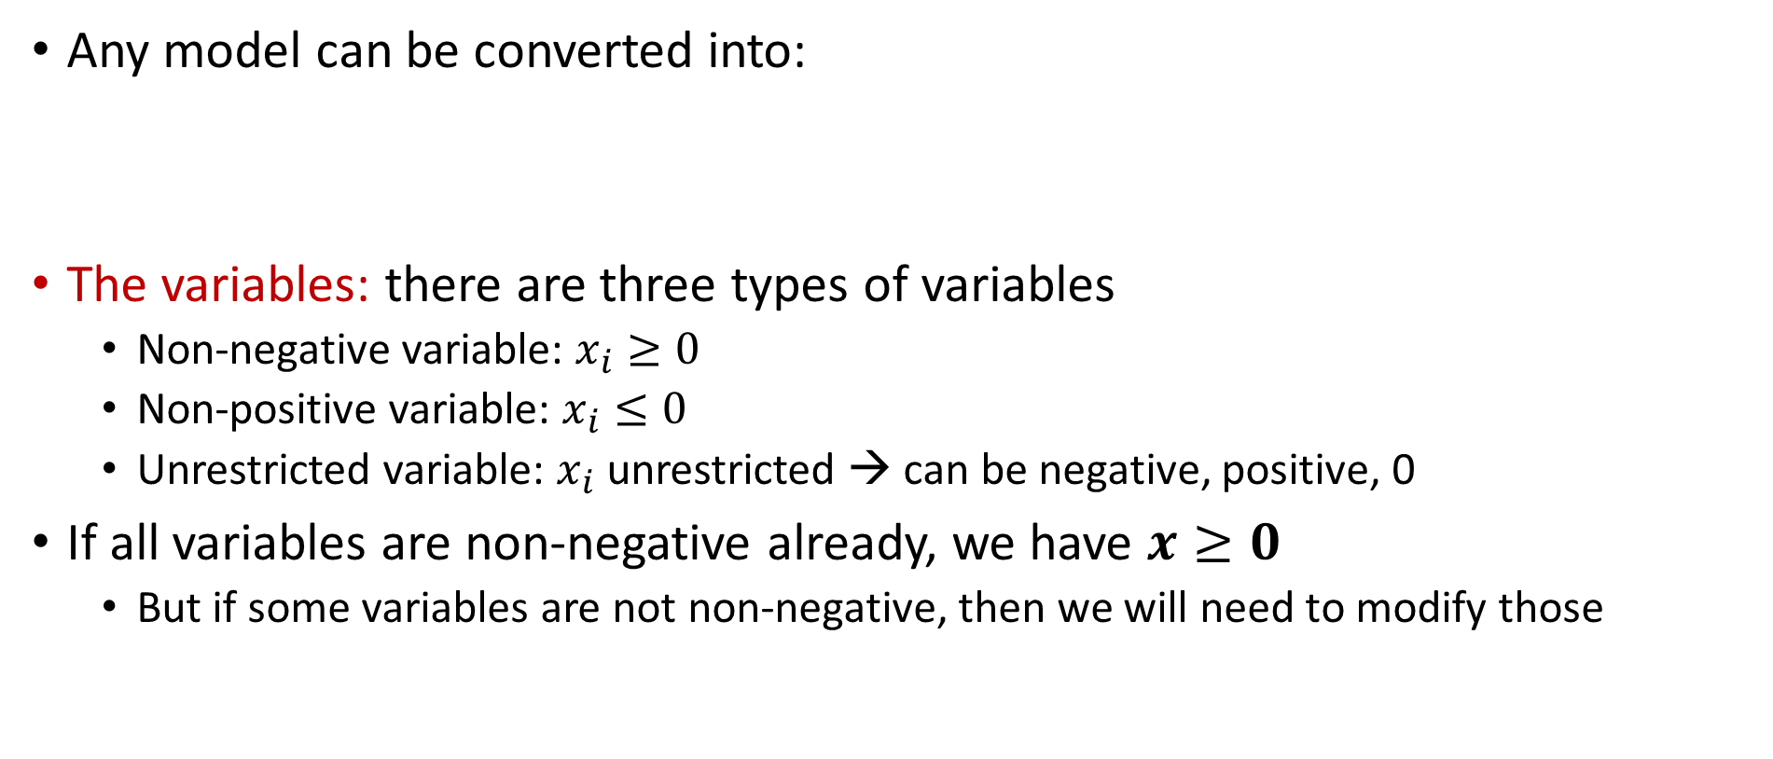
Matrix Notation
Any model can be converted into:
The variables: there are three types of variables
  Non-negative variable: $x_{i}≥0$
  Non-positive variable: $x_{i}≤0$
  Unrestricted variable: $x_{i}$ unrestricted → can be negative, positive, 0
If all variables are non-negative already, we have $x≥0$
  But if some variables are not non-negative, then we will need to modify those

Slide 18
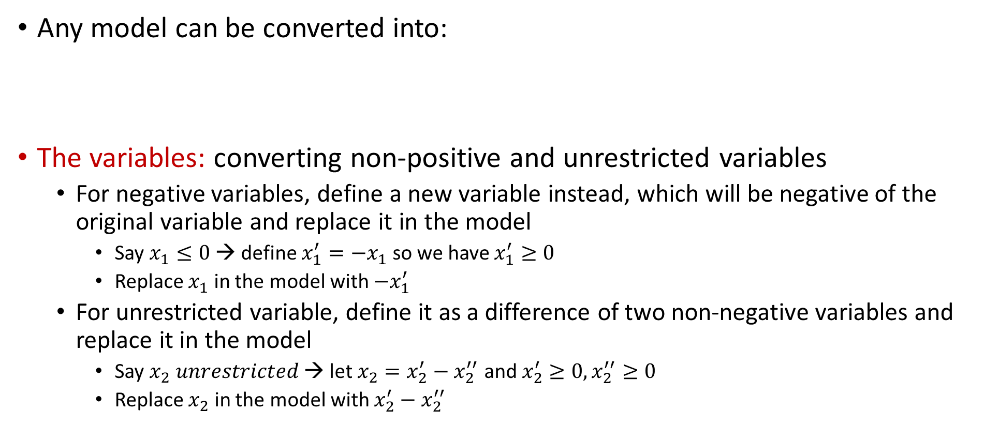
Matrix Notation
Any model can be converted into:
The variables: converting non-positive and unrestricted variables
  For negative variables, define a new variable instead, which will be negative of the original variable and replace it in the model
    Say $x_{1}≤0$ → define $x_{1}^{′}=−x_{1}$ so we have $x_{1}^{′}≥0$
    Replace $x_{1}$ in the model with ${−x}_{1}^{′}$
  For unrestricted variable, define it as a difference of two non-negative variables and replace it in the model
    Say $x_{2} unrestricted$ → let $x_{2}=x_{2}^{′}−x_{2}^{′′}$ and $x_{2}^{′}≥0,x_{2}^{′′}≥0$
    Replace $x_{2}$ in the model with $x_{2}^{′}−x_{2}^{′′}$

Slide 19


Matrix Notation
A small example:
  So the constraints are handled easily
    1st constraint → multiply both sides with -1
    2nd constraint → replace it with >= and <=, and then multiply the >=‘s both sides with -1
    The last constraint is <= already
  Minimize ${x_{1}+x}_{2}−2x_{3}$
  subject to ${x_{1}−2x}_{2}+{4x}_{3}≥13$
  $x_{1}+{ x}_{2}{+ 5x}_{3} =17$
  $x_{3}≤4$
  $x_{1}≤0,$
  $x_{2} unrestricted,$
  $x_{3}≥0,$
  Minimize ${x_{1}+x}_{2}−2x_{3}$
  subject to ${{−x}_{1}+2x}_{2}−{4x}_{3}≤−13$
  $x_{1}+{ x}_{2}{+ 5x}_{3}≤17$
  $−x_{1}−x_{2}{− 5x}_{3}≤−17$
  $x_{3}≤4$
  $x_{1}≤0,$
  $x_{2} unrestricted,$
  $x_{3}≥0,$

Slide 20
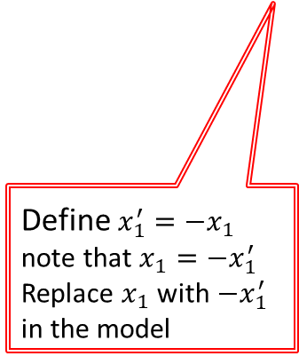


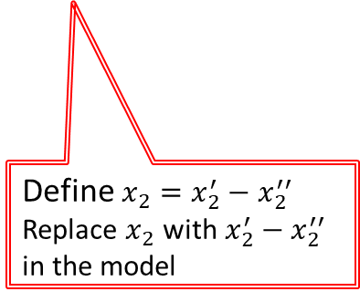
Matrix Notation
A small example:
  Minimize ${x_{1}+x}_{2}−2x_{3}$
  subject to ${{−x}_{1}+2x}_{2}−{4x}_{3}≤−13$
  $x_{1}+{ x}_{2}{+ 5x}_{3}≤17$
  $−x_{1}−x_{2}{− 5x}_{3}≤−17$
  $x_{3}≤4$
  $x_{1}≤0,$
  $x_{2} unrestricted,$
  $x_{3}≥0,$
  Minimize $−{x_{1}^{′}+x}_{2}^{′}−x_{2}^{′′}−2x_{3}$
  subject to ${{x′}_{1}+2x′}_{2}−2x_{2}^{′′}−{4x}_{3}≤−13$
  ${−x′}_{1}+{ x′}_{2}−x_{2}^{′′}{+ 5x}_{3}≤17$
  ${x′}_{1}−{x^{′}}_{2}+x_{2}^{′′}{− 5x}_{3}≤−17$
  $x_{3}≤4$
  ${x′}_{1}≥0,$
  ${x′}_{2}≥0,$
  ${x′′}_{2}≥0,$
  $x_{3}≥0,$
Define $x_{1}^{′}=−x_{1}$ note that $x_{1}=−x_{1}^{′}$
Replace $x_{1}$ with $−x_{1}^{′}$ in the model
Define $x_{2}=x_{2}^{′}−x_{2}^{′′}$
Replace $x_{2}$ with $x_{2}^{′}−x_{2}^{′′}$ in the model
If you want objective to be “maximization”, then multiply the objective function with -1…

Slide 21


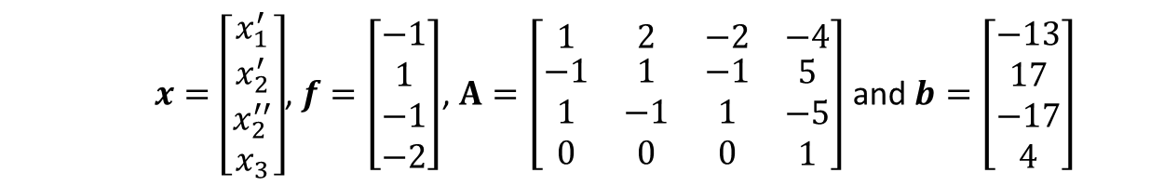

Matrix Notation
A small example:
  Furthermore, let
  Note that when you solve the new model, do not forget
    $x_{1}=−x_{1}^{′}$ and $x_{2}=x_{2}^{′}−x_{2}^{′′}$
  Minimize $−{x_{1}^{′}+x}_{2}^{′}−x_{2}^{′′}−2x_{3}$
  subject to ${{x′}_{1}+2x′}_{2}−2x_{2}^{′′}−{4x}_{3}≤−13$
  ${−x′}_{1}+{ x′}_{2}−x_{2}^{′′}{+ 5x}_{3}≤17$
  ${x′}_{1}−{x^{′}}_{2}+x_{2}^{′′}{− 5x}_{3}≤−17$
  $x_{3}≤4$
  ${x′}_{1}≥0,$
  ${x′}_{2}≥0,$
  ${x′′}_{2}≥0,$
  $x_{3}≥0,$
  Minimize ${x_{1}+x}_{2}−2x_{3}$
  subject to ${x_{1}−2x}_{2}+{4x}_{3}≥13$
  $x_{1}+{ x}_{2}{+ 5x}_{3} =17$
  $x_{3}≤4$
  $x_{1}≤0,$
  $x_{2} unrestricted,$
  $x_{3}≥0,$
    $x=\left[\begin{aligned}x_{1}^{′} \\ x_{2}^{′} \\ x_{2}^{′′} \\ x_{3}\end{aligned}\right]$, $f=\left[\begin{aligned}−1 \\ 1 \\ −1 \\ −2\end{aligned}\right]$, $A=\left[\begin{matrix}1 & 2 & −2 & −4 \\ \begin{aligned}−1 \\ 1 \\ 0\end{aligned} & \begin{aligned}1 \\ −1 \\ 0\end{aligned} & \begin{aligned}−1 \\ 1 \\ 0\end{aligned} & \begin{aligned}5 \\ −5 \\ 1\end{aligned}\end{matrix}\right]$ and $b=\left[\begin{aligned}−13 \\ 17 \\ −17 \\ 4\end{aligned}\right]$

Slide 22
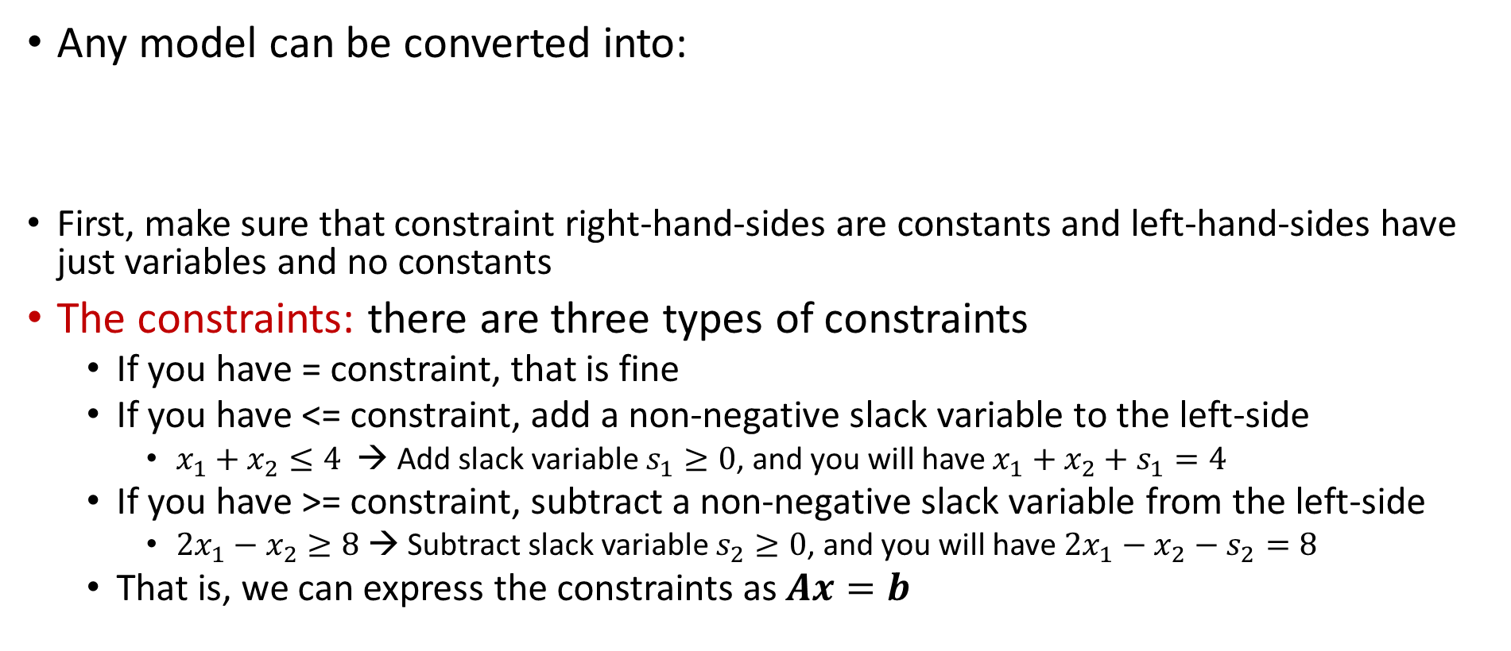
Matrix Notation
Any model can be converted into:
First, make sure that constraint right-hand-sides are constants and left-hand-sides have just variables and no constants
The constraints: there are three types of constraints
  If you have = constraint, that is fine
  If you have <= constraint, add a non-negative slack variable to the left-side
    $x_{1}+x_{2}≤4$ → Add slack variable $s_{1}≥0$, and you will have $x_{1}+x_{2}+s_{1}=4$
  If you have >= constraint, subtract a non-negative slack variable from the left-side
    ${2x}_{1}−x_{2}≥8$→ Subtract slack variable $s_{2}≥0$, and you will have ${2x}_{1}−x_{2}−s_{2}=8$
  That is, we can express the constraints as $Ax=b$

Slide 23
Matrix Notation
Any model can be converted into:
The variables: converting non-positive and unrestricted variables
  For negative variables, define a new variable instead, which will be negative of the original variable and replace it in the model
    Say $x_{1}≤0$ → define $x_{1}^{′}=−x_{1}$ so we have $x_{1}^{′}≥0$
    Replace $x_{1}$ in the model with ${−x}_{1}^{′}$
  For unrestricted variable, define it as a difference of two non-negative variables and replace it in the model
    Say $x_{2} unrestricted$ → let $x_{2}=x_{2}^{′}−x_{2}^{′′}$ and $x_{2}^{′}≥0,x_{2}^{′′}≥0$
    Replace $x_{2}$ in the model with $x_{2}^{′}−x_{2}^{′′}$

Slide 24


Matrix Notation
A small example:
  So the constraints are handled easily
    1st constraint → subtract $s_{1}≥0$ from the left side
    2nd constraint is = already
    3rd constraint → add $s_{2}≥0$ to the left side
  Minimize ${x_{1}+x}_{2}−2x_{3}$
  subject to ${x_{1}−2x}_{2}+{4x}_{3}≥13$
  $x_{1}+{ x}_{2}{+ 5x}_{3} =17$
  $x_{3}≤4$
  $x_{1}≤0,$
  $x_{2} unrestricted,$
  $x_{3}≥0,$
  Minimize ${x_{1}+x}_{2}−2x_{3}$
  subject to ${x_{1}−2x}_{2}+{4x}_{3}−s_{1}=13$
  $x_{1}+{ x}_{2}{+ 5x}_{3}=17$
  $x_{3}+s_{2}=4$
  $x_{1}≤0,$
  $x_{2} unrestricted,$
  $x_{3}≥0,$
$s_{1}≥0$
  $s_{2}≥0$

Slide 25
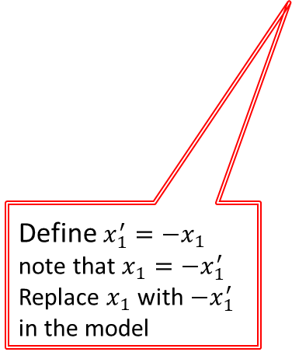


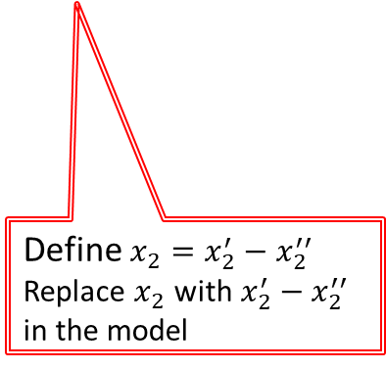
Matrix Notation
A small example:
  Minimize ${x_{1}+x}_{2}−2x_{3}$
  subject to ${x_{1}−2x}_{2}+{4x}_{3}−s_{1}=13$
  $x_{1}+{ x}_{2}{+ 5x}_{3}=17$
  $x_{3}+s_{2}=4$
  $x_{1}≤0,$
  $x_{2} unrestricted,$
  $x_{3}≥0,$
$s_{1}≥0$
  $s_{2}≥0$
  Minimize $−{x_{1}^{′}+x}_{2}^{′}−x_{2}^{′′}−2x_{3}$
  subject to ${{−x′}_{1}−2x′}_{2}+2x_{2}^{′′}+{4x}_{3}−s_{1}=13$ ${−x′}_{1}+{ x′}_{2}−x_{2}^{′′}{+ 5x}_{3}=17$
  $x_{3}+s_{2}=4$
  ${x′}_{1}≥0,$
  ${x′}_{2}≥0,$
  ${x′′}_{2}≥0,$
  $x_{3}≥0,$
$s_{1}≥0$
  $s_{2}≥0$
Define $x_{1}^{′}=−x_{1}$ note that $x_{1}=−x_{1}^{′}$
Replace $x_{1}$ with $−x_{1}^{′}$ in the model
Define $x_{2}=x_{2}^{′}−x_{2}^{′′}$
Replace $x_{2}$ with $x_{2}^{′}−x_{2}^{′′}$ in the model
If you want objective to be “maximization”, then multiply the objective function with -1…

Slide 26


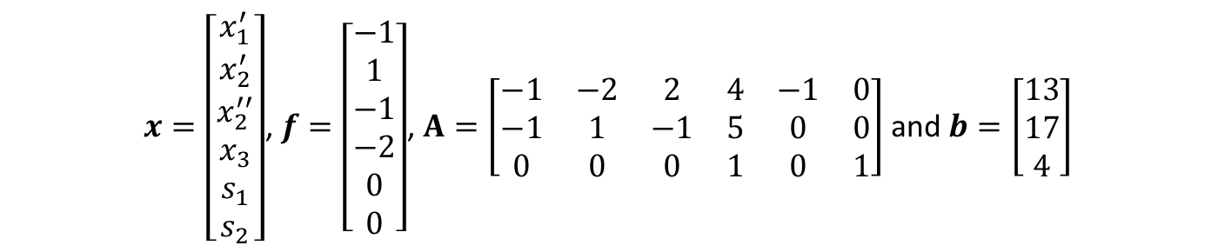
Matrix Notation
A small example:
  Furthermore, let
  Note that when you solve the new model, do not forget
    $x_{1}=−x_{1}^{′}$ and $x_{2}=x_{2}^{′}−x_{2}^{′′}$
  Minimize $−{x_{1}^{′}+x}_{2}^{′}−x_{2}^{′′}−2x_{3}$
  subject to ${{−x′}_{1}−2x′}_{2}+2x_{2}^{′′}+{4x}_{3}−s_{1}=13$ ${−x′}_{1}+{ x′}_{2}−x_{2}^{′′}{+ 5x}_{3}=17$
  $x_{3}+s_{2}=4$
  ${x′}_{1}≥0,$
  ${x′}_{2}≥0,$
  ${x′′}_{2}≥0,$
  $x_{3}≥0,$
$s_{1}≥0$
  $s_{2}≥0$
  Minimize ${x_{1}+x}_{2}−2x_{3}$
  subject to ${x_{1}−2x}_{2}+{4x}_{3}≥13$
  $x_{1}+{ x}_{2}{+ 5x}_{3} =17$
  $x_{3}≤4$
  $x_{1}≤0,$
  $x_{2} unrestricted,$
  $x_{3}≥0,$
    $x=\left[\begin{aligned}x_{1}^{′} \\ x_{2}^{′} \\ x_{2}^{′′} \\ x_{3} \\ s_{1} \\ s_{2}\end{aligned}\right]$, $f=\left[\begin{aligned}−1 \\ 1 \\ −1 \\ −2 \\ 0 \\ 0\end{aligned}\right]$, $A=\left[\begin{matrix}−1 & −2 & 2 & 4 & −1 & 0 \\ −1 & 1 & −1 & 5 & 0 & 0 \\ 0 & 0 & 0 & 1 & 0 & 1\end{matrix}\right]$ and $b=\left[\begin{aligned}13 \\ 17 \\ 4\end{aligned}\right]$

Slide 27
Matrix Notation
Matrix notation is commonly used for linear models!

Slide 28
Outline
Compact Formulation (not in the textbook)
Matrix Notation (not in the textbook)
Matrix Notation for Network Optimization (not in the textbook)
Examples (not in the textbook)
Phyton Introduction

Slide 29
Matrix Notation for Networks
Matrix Notation:
The network optimization problems we discussed are linear programming models, so we can effectively use matrix notation for them
Same as representing any other LP problem in matrix notation
  Create the objective function vector, constraint matrix, and right-hand-sides vector
Constraints
  Flow balance constraints are modeled using node-arc incidence matrix
  Node-arc incidence matrix:
    Rows correspond to nodes
    Columns correspond to arcs

Slide 30
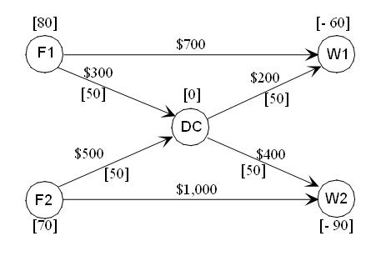
Matrix Notation for Networks
Matrix Notation:
Node-arc incidence matrix:
The column for arc (i,j) has two non-zero values:
  +1 in the row for node i
  -1 in the row for node j
  In other rows, 0
If you do not have flow-balance constraint for a node, just do not include a row for it!
A

Slide 31
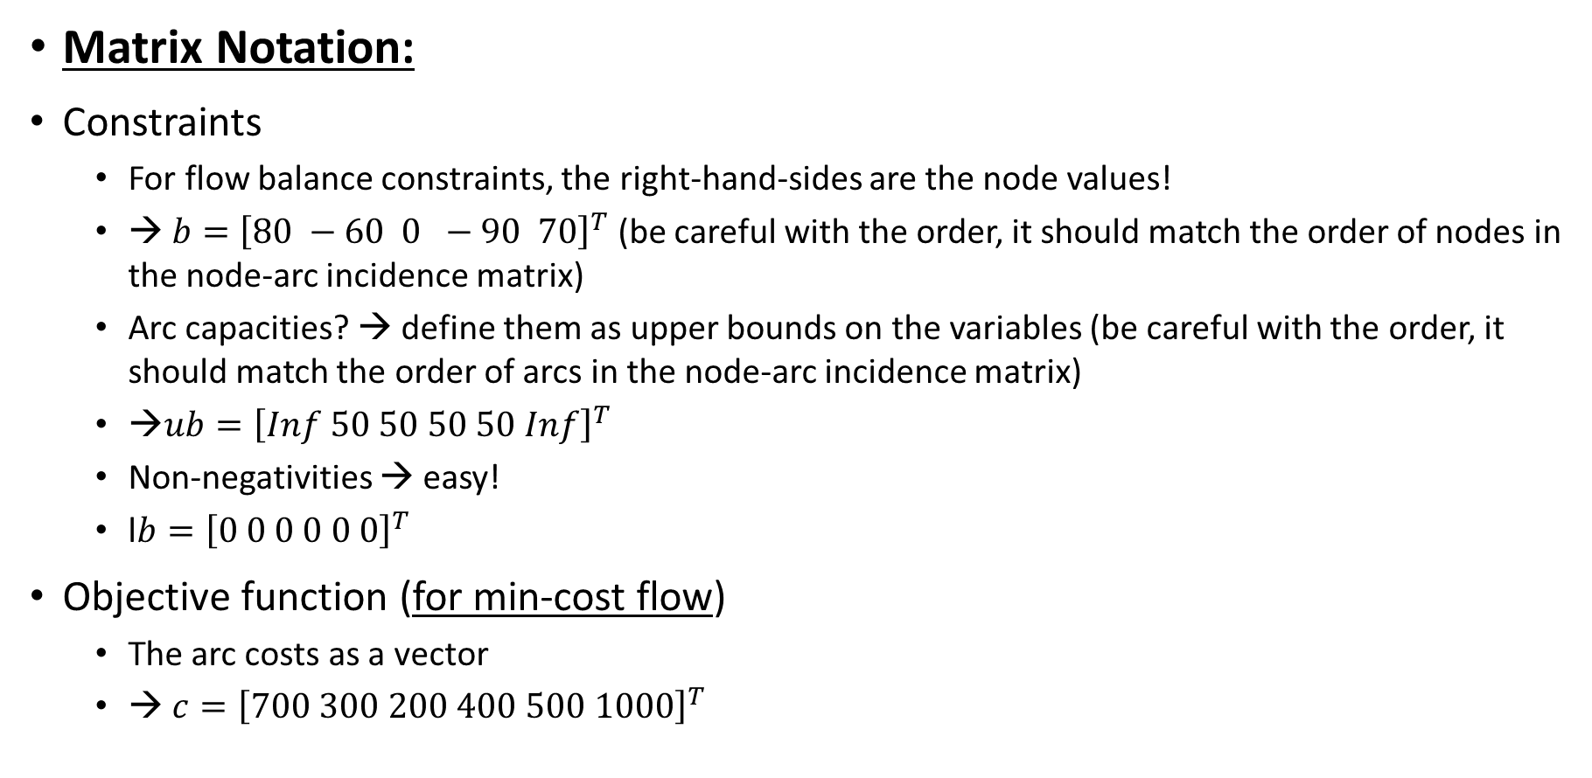
Matrix Notation for Networks
Matrix Notation:
Constraints
  For flow balance constraints, the right-hand-sides are the node values!
  → $b={\left[80 −60 0 −90 70\right]}^{T}$ (be careful with the order, it should match the order of nodes in the node-arc incidence matrix)
  Arc capacities? → define them as upper bounds on the variables (be careful with the order, it should match the order of arcs in the node-arc incidence matrix)
  →$ub={\left[Inf 50 50 50 50 Inf\right]}^{T}$
  Non-negativities → easy!
  l$b={\left[0 0 0 0 0 0\right]}^{T}$
Objective function (for min-cost flow)
  The arc costs as a vector
  → $c={\left[700 300 200 400 500 1000\right]}^{T}$

Slide 32

Matrix Notation for Networks
Matrix Notation:
For Distribution Unlimited case:
Minimize 700X(F1,W1) + 300X(F1,DC) + 200X(DC,W1) +400X(DC,W2) + 500X(F2,DC) + 1000X(F2,W2)
Subject to X(F1,DC) + X(F1,W1) = 80
X(F2,DC) + X(F2,W2) = 70
[X(DC,W1) + X(DC,W2)] - [X(F1,DC) + X(F2,DC) ]=0
-[X(F1,W1) + X(DC,W1)] = -60
-[X(F2,W2) + X(DC,W2)]= -90
    X(F1,DC)<=50
    X(F2,DC)<=50
    X(DC,W1)<=50
    X(DC,W2)<=50
    X(i,j)>=0 for all arcs (i,j)
$Minimize$ $c^{T}x$
$Subject to$ $Ax=b$
$lb≤x≤ub$

Slide 33
Outline
Compact Formulation (not in the textbook)
Matrix Notation (not in the textbook)
Matrix Notation for Network Optimization (not in the textbook)
Examples (not in the textbook)
Phyton Introduction

Slide 34
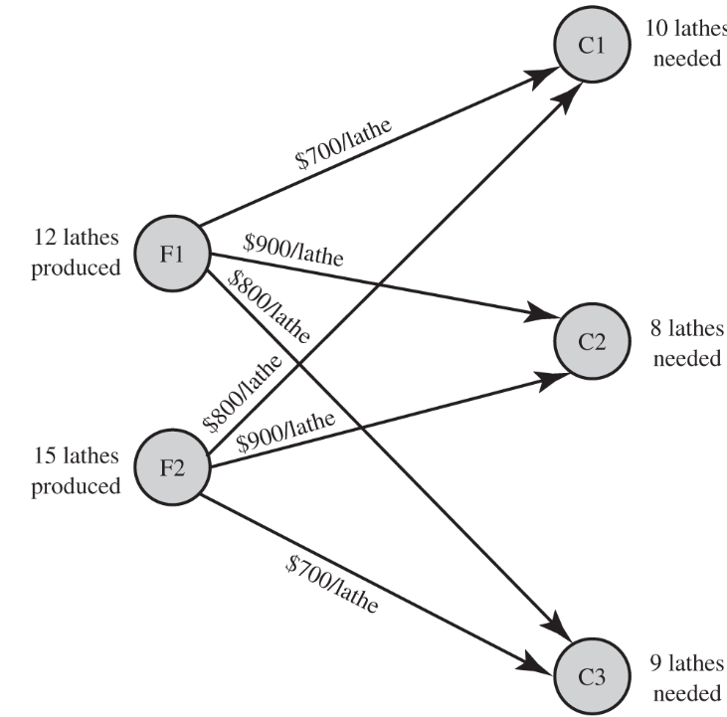
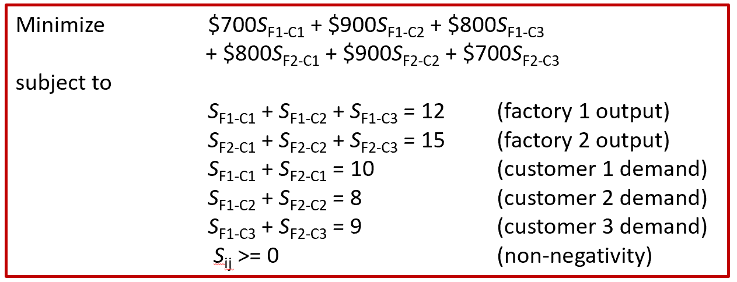






Examples
Big M Company Transportation Problem (Chapter 3.5)
                Let factories be indexed by i, i=1,2 and customers be indexed by j, j=1,2,3
                Let Cij : cost of shipping one unit from factory i to customer j
                Let Si: supply amount in factory i
                Let Dj: demand of customer j
                Define Qij: quantity shipped from factory i to customer j
                → Recall that there are 6 decision variables
                → And total supply is equal to total demand
Input data
Decision variables
$$\sum_{i=1}^{2}{\sum_{j=1}^{3}{c_{ij}Q_{ij}}}$$
$$Minimize$$
$$\sum_{j=1}^{2}{Q_{ij}}=S_{i} ∀i=1,2$$
$$subject to$$
Compact model
$$\sum_{i=1}^{3}{Q_{ij}}=D_{j} ∀j=1,2, 3$$
$$Q_{ij}≥0 ∀i=1,2, ∀j=1,2,3$$

Slide 35

Examples
Big M Company Transportation Problem (Chapter 3.5)
  Let $x={\left[Q_{11},Q_{12},Q_{13},Q_{21},Q_{22},Q_{23}\right]}^{T}$ and $f={\left[700, 900, 800, 800, 900, 700\right]}^{T}$
  $A=\left[\begin{matrix}1 & 1 & 1 & 0 & 0 & 0 \\ 0 & 0 & 0 & 1 & 1 & 1 \\ 1 & 0 & 0 & 1 & 0 & 0 \\ 0 & 1 & 0 & 0 & 1 & 0 \\ 0 & 0 & 1 & 0 & 0 & 1\end{matrix}\right]$ and $b=\left[\begin{matrix}12 \\ \begin{aligned}15 \\ 10 \\ 8 \\ 9\end{aligned}\end{matrix}\right]$

Slide 36
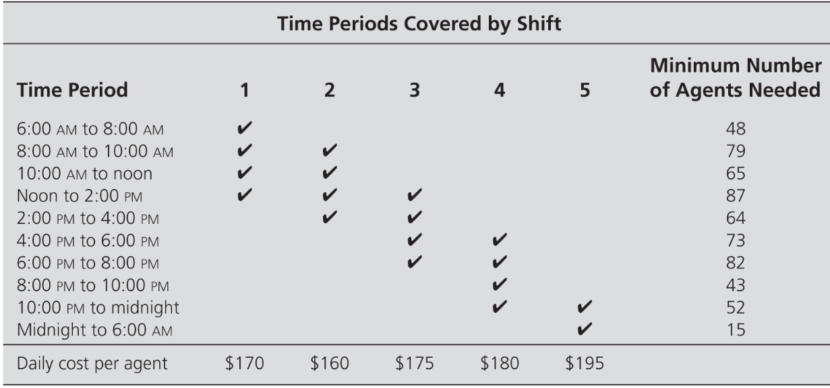
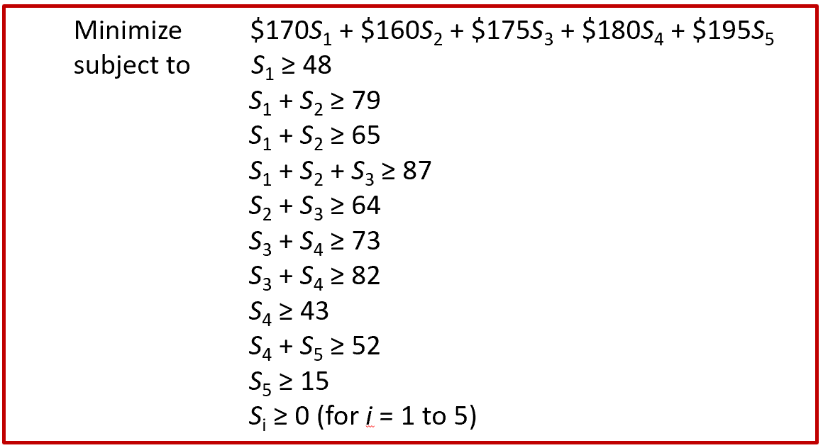
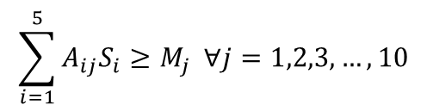


Examples
Union Airways Personnel Scheduling Problem (Chapter 3.3)
                Let shifts be indexed by i, i=1,2,…,5 and time-periods be indexed by j, j=1,2,…,10
                Let Ci : cost of one agent hired for shift i
                Let Mj: the min number of agents required for time-period j
                Let Aij: 1 if shift i covers time-period j, 0 otherwise
                Define Si: number of agents hired for shift i
Input data
Decision variables
$$\sum_{i=1}^{5}{C_{i}S_{i}}$$
$$Minimize$$
$$\sum_{i=1}^{5}{A_{ij}S_{i}}≥M_{j} ∀j=1,2,3,…,10$$
Compact model
$$subject to$$
$$S_{i}≥0 ∀i=1,2,3,4,5$$

Slide 37


Examples
Union Airways Personnel Scheduling Problem (Chapter 3.3)
  Let $x={\left[S_{1},S_{2},S_{3},S_{4},S_{5}, \right]}^{T}$ and $f={\left[170, 160, 175, 180, 195\right]}^{T}$
  $A=\left[\begin{matrix}1 & 0 & 0 & 0 & 0 \\ 1 & 1 & 0 & 0 & 0 \\ 1 & 1 & 0 & 0 & 0 \\ 1 & 1 & 1 & 0 & 0 \\ 0 & 1 & 1 & 0 & 0 \\ 0 & 0 & 1 & 1 & 0 \\ 0 & 0 & 1 & 1 & 0 \\ 0 & 0 & 0 & 1 & 0 \\ 0 & 0 & 0 & 1 & 1 \\ 0 & 0 & 0 & 0 & 1\end{matrix}\right]$ and $b=\left[\begin{matrix}48 \\ \begin{aligned}79 \\ 65 \\ 87 \\ 64 \\ 73 \\ 82 \\ 43 \\ 52 \\ 15\end{aligned}\end{matrix}\right]$

Slide 38
Outline
Compact Formulation (not in the textbook)
Matrix Notation (not in the textbook)
Matrix Notation for Network Optimization (not in the textbook)
Examples (not in the textbook)
Phyton Introduction

Slide 39
Limitations of Excel Solver
Excel solver capacity is limited.
  200 decision variables
  100 cell constraints on nonlinear problems.
Excel models cannot be easily scaled.
The choice of algorithms to use is limited.
  Simplex method for linear and GRG for nonlinear optimization
Solver cannot easily handle large-scaled data.

Slide 40
Various Optimization Platforms
Enviroments
MS Excel Solver
MATLAB
Python(SciPy)
Gurobi
C++
Python(PuLP)

Slide 41
Overview of PuLP
PuLP is a Python scripting language that allows users to leverage the power and flexibility of Python to describe optimization models.
PuLP is designed for modeling both linear programming (LP) and mixed-integer programming (MIP) problems.
With PuLP, you can write optimization problems in a clear and concise manner using standard mathematical notation very compactly.
PuLP is open-source and freely available, and can interface with various optimization solvers, including both open-source solvers (e.g., CBC, GLPK) and commercial solvers (e.g., Gurobi, IBM CPLEX).

Slide 42
Overview of PuLP
Python has rich data processing capabilities; thus, PuLP can serve as a natural interface between predictive analytics and optimization.
PuLP can easily be deployed on any system that has a Python interpreter, as it has no dependencies on any other software packages.
PuLP provides tools for performing sensitivity analysis to understand how changes in problem parameters affect the solution.
PuLP tutorial and various case studies are available online at:
https://coin-or.github.io/pulp/

Slide 43

Installing PuLP
To install on Anaconda:
  See the various installation methods provided at:
            https://pypi.org/project/PuLP/
To check if PuLP has been properly installed for Anaconda:
  Go to Anaconda Navigator
  Choose ‘Enviroments’
  Type pulp in the box in the top right corner.
  If pulp appears in the list, it means the PuLP has been installed.

Slide 44
Formulating LP Problems using PuLP
LP Model
PuLP
  Define the LP problem:
  prob =LpProblem(“name”,LpMaximize)
  Define parameter lists/matrices and index sets:
    Define/Import parameter lists/matrices: c, a, b
    Define index set for decision variables, using a list, say, N
    Define index sets for constraints , using lists, say, M, J1, J2, J3
  Create parameter dictionaries using index set as keys and parameter list as values:
    e.g., objective function coefficients c = dict(zip(N,c))
    e.g., RHS constants, b=dict(zip(M,b))
    e.g., Constraint matrix, a = MakeDict([N,M], a)
Parameter and data structure preparation

Slide 45
Formulating LP Problems using PuLP
LP Model
PuLP
  Define decision variable dictionary using index set as keys
    x=LpVariable.dicts(”x”,N, lowBound=0, cat=“Continuous”)
  Define Objective function
  prob +=lpSum([c[i]*x[i] for i in N])
  Define Constraints
    Use for loop to add constraints in “groups”
    for j in J1:
    prob +=lpSum([a[i][j]*x[i] for i in N]) == b[j]
    for j in J2:
    prob +=lpSum([a[i][j]*x[i] for i in N]) <= b[j]
    for j in J3:
    prob +=lpSum([a[i][j]*x[i] for i in N]) >= b[j]
  7. Solve
  prob.solve()
Problem formulation

Slide 46
A Blending Problem – Riverside Oil Company
Riverside Oil Company in eastern Kentucky produces regular and supreme gasoline. Each barrel of regular sells for $21 and must have an octane rating of at least 90. Each barrel of supreme sells for $25 and must have an octane rating of at least 97. Each of these types of gasoline are manufactured by mixing different quantities of the following three inputs:
Riverside has orders for 300,000 barrels of regular and 450,000 barrels of supreme. How should the company allocate the available inputs to the production of regular and supreme gasoline if it wants to maximize proﬁts?
Input | Cost per Barrel | Octane Rating | Barrels Available (in 1000s)
1 | $17.25 | 100 | 150
2 | $15.75 | 87 | 350
3 | $17.75 | 110 | 300

Slide 47

A Blending Problem – Riverside Oil Company
Problem Formulation
$$maximize 21\left(x_{1R}+x_{2R}+x_{3R}\right)+25\left(x_{1S}+x_{2S}+x_{3S}\right)−17.25\left(x_{1R}+x_{1S}\right)−15.75\left(x_{2R}+x_{2S}\right)−17.75(x_{3R}+x_{3S})$$
$$subject to { x}_{1R}+x_{1S}≤150$$
$x_{2R}+x_{2S}≤350$
$x_{3R}+x_{3S}≤300$
$x_{1R}+x_{2R}+x_{3R}≤300$
$x_{1S}+x_{2S}+x_{3S}≤450$
$\left(100 x_{1R}+87 x_{2R}+110 x_{3R}\right)≥90(x_{1R}+x_{2R}+x_{3R})$
$\left(100 x_{1S}+87 x_{2S}+110 x_{3S}\right)≥97(x_{1S}+x_{2S}+x_{3S})$
Supply Constraints
Demand Constraints
Octane Requirement Constraints

Slide 48





A Blending Problem – Riverside Oil Company
Total Revenue
$$\max{\sum_{j=R, S}{p_{j } \sum_{i=1, 2, 3}{x_{ij}}}− \sum_{i=1, 2, 3}{c_{i}\sum_{j=R, S}{x_{ij}}}}$$
Problem Formulation
$$maximize 21\left(x_{1R}+x_{2R}+x_{3R}\right)+25\left(x_{1S}+x_{2S}+x_{3S}\right)$$
$−17.25\left(x_{1R}+x_{1S}\right)−15.75\left(x_{2R}+x_{2S}\right)−17.75(x_{3R}+x_{3S})$
$$subject to { x}_{1R}+x_{1S}≤150$$
$x_{2R}+x_{2S}≤350$
$x_{3R}+x_{3S}≤300$
$x_{1R}+x_{2R}+x_{3R}≤300$
$x_{1S}+x_{2S}+x_{3S}≤450$
$\left(100 x_{1R}+87 x_{2R}+110 x_{3R}\right)≥90(x_{1R}+x_{2R}+x_{3R})$
$\left(100 x_{1S}+87 x_{2S}+110 x_{3S}\right)≥97(x_{1S}+x_{2S}+x_{3S})$
Total Cost
$$s.t.\sum_{j=R, S}{x_{ij}≤S_{i}} for i=1, 2, 3$$
$$\sum_{i=1, 2, 3}{x_{ij}≤D_{j}} for j=R, S$$
$$\sum_{i=1, 2, 3}{r_{i}(x_{ij})}=R_{j}\sum_{i=1, 2, 3}{x_{ij}} for j=R, S$$

Slide 49



A Blending Problem – PuLP
Import PuLP modeler functions:
Define an LP problem:
Define the parameters and the decision variables:
variable name
problem name
LP problem objective
LpVariable class: LpVariable(name, lowBound=None, upBound=None, cat='Continuous').
name: The name of the variable used in the output.lp file
lowBound: The lower bound on this variable’s range. Default is negative infinity
upBound: The upper bound on this variable’s range. Default is positive infinity
cat: The category this variable is in, Integer, Binary, or Continuous (default)

Slide 50

A Blending Problem - PuLP
Generate data:

Slide 51

A Blending Problem - PuLP
Add the objective function and constraints to the LP problem using “+=” operator:

Slide 52

A Blending Problem - PuLP

Slide 53

A Blending Problem - PuLP
Run the solver :
There are 5 status that can be returned from a solver in PuLP:
    Optimal: Optimal solution exists and is found.
    Not Solved: Is the default setting before a problem has been solved.
    Infeasible: The problem has no feasible solution.
    Unbounded: The objective function is unbounded.
    Undefined: Feasible solution hasn't been found (but may exist).
1 | 2 | 3 | 4 | 5
Optimal | Not Solved | Infeasible | Unbounded | Undefined

Slide 54

A Blending Problem - PuLP
Print the solution

